Slide 1

PhD Course on Social Network Analysis
Prof. Dr. Daniel Fürstenau 20 February 2017

Slide 2
Agenda
Introduction and examples
Fundamental concepts
Creating graphs
Visualizing graphs
Centrality
Describing the macro structure
Community detection
Getting and handling data
Extended concepts
Discussion and conclusion

Slide 3
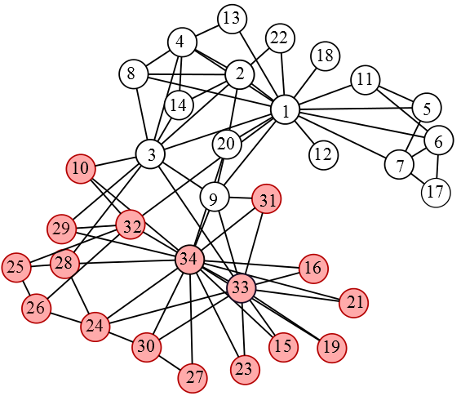
Introduction 1: Zachary‘s Karate Club Network
The Iris dataset of social network analysis
A social network of a karate club was studied by Wayne W. Zachary for a period of three years from 1970 to 1972. The network captures 34 members of a karate club, documenting 78 pairwise links between members who interacted outside the club. During the study a conflict arose which led to the split of the club into two. Based on collected data Zachary assigned correctly all but one member of the club to the groups they actually joined after the split.

Slide 4
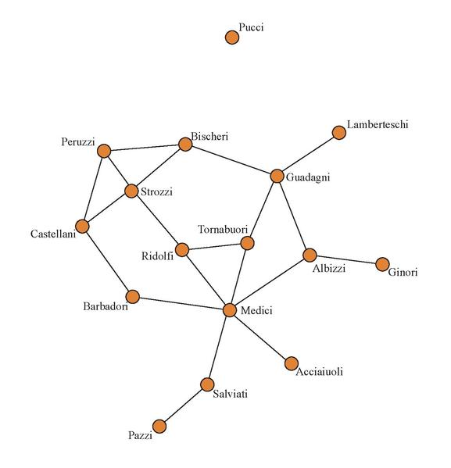
Introduction 2: 15th Century Florentine Marriages
[Padgett and Ansell, 1993]
Notes:
The graph above is a marriage network of 16 influential Florentian families in the 1430s. At this time in Renaissance Italy, the major families were essentially an oligarchy, controlling politics and money in the region.

Slide 5
Introduction 3: Add Health School Friendship Network
Notes:
The graph above is a marriage network of 16 influential Florentian families in the 1430s. At this time in Renaissance Italy, the major families were essentially an oligarchy, controlling politics and money in the region.

Slide 6
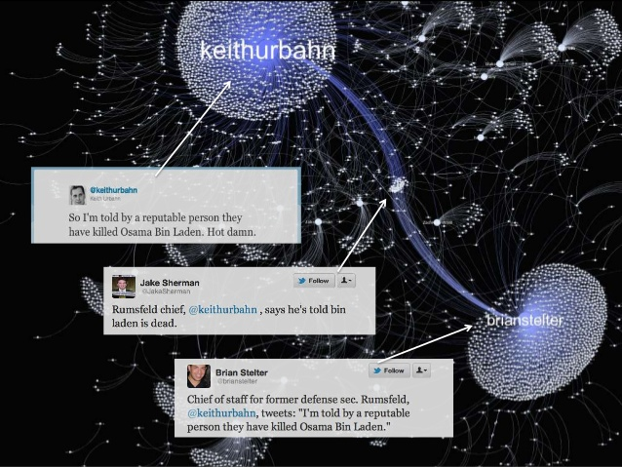
Introduction 4: Retweet network from Twitter
[https://www.slideshare.net/giladlotan/pydata-gilad-networkxupload]

Slide 7
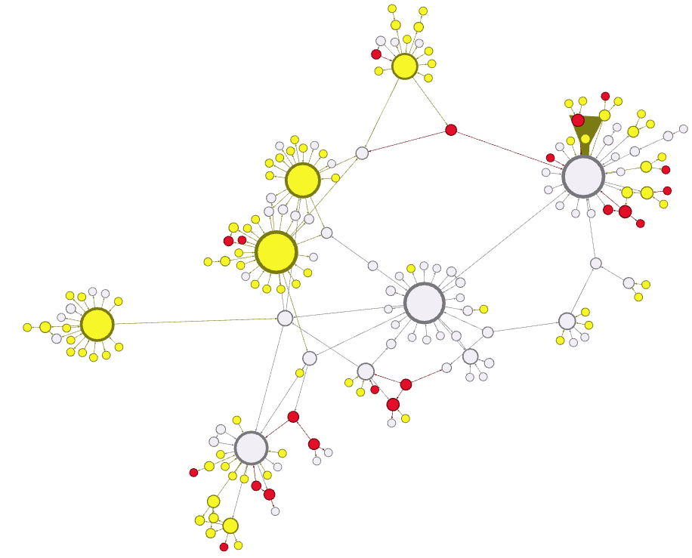
Introduction 5: Recyle Inc. Information Infrastructure Network
Centrally managed
Shadow IT candidate
Shadow IT
[Fuerstenau et al. 2014]

Slide 8
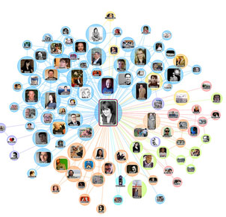
Definitions
Network: a pattern of interconnections among a set of things
Social Network: a network where the things are people and the interconnections are social interactions
Social Network Analysis (SNA): the application of graph and network theory / network science to investigate social structures.
Graph theory: a branch of mathematics concerned with modeling pairwise interactions among objects
Network theory: Theorizing networks includes at least: individual elements; pair-wise relationships between those elements; and a global or macro- patterning that can be considered as network structure (Brandes et al. 2013)
Network science: The interdisciplinary, empirical, data-driven, quantitative, computational study of network models (view of Laslo Barabasi).
Notes:
The features of a network abstraction include at least the following: individual elements; pair-wise relationships between those elements; and a global or macro- patterning that can be considered as network structure (Brandes et al. 2013)

Slide 9




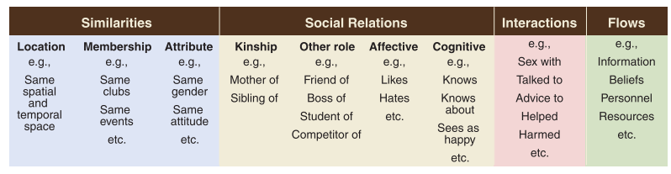
Types of social interactions
[Borgatti et al. 2009]

Slide 10
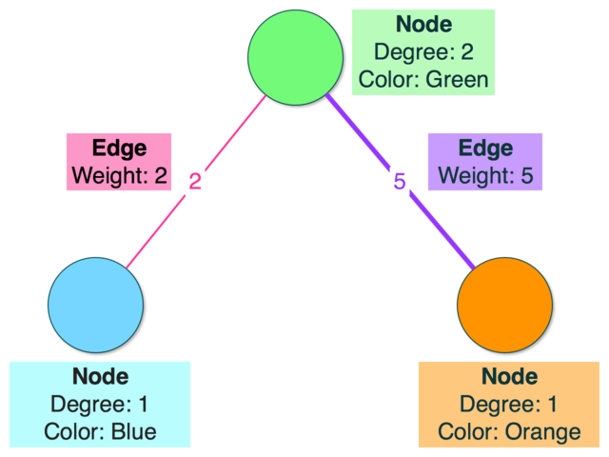
Parts of a network: Nodes and links
Node / Vertex: The entity of analysis which has a relationship. Node is used in the network context, vertex is used in the graph theory context, but both terms are often used interchangeably.
Link / Edge / Relationship: The connections between the nodes. Link is used in the network context, edge is used in the graph theory context, and all words are used interchangably with relationship.
Attributes: Both nodes and links can store attributes, which contain additional data about that object.
Weight: A common attribute of links, used to indicate strength or value of a relationship.
Degree: Number of links a node has.
Link
Link

Slide 11
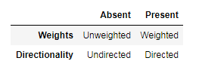
Types of networks
Networks are typically classified based on the presence of weights and direction attached to the links in a graph. The table below covers what we call each type of graph:
Additional flavors: parallel links, self-loops, n-partite graphs
In this context:
We are talking about a(n) [unweighted/weighted] [undirected/directed] graph (with [parallel edges | self loops]).

Slide 12
Agenda
Introduction and examples
Fundamental concepts
Creating graphs
Visualizing graphs
Centrality
Describing the macro structure
Community detection
Getting and handling data
Extended concepts
Discussion and conclusion

Slide 13
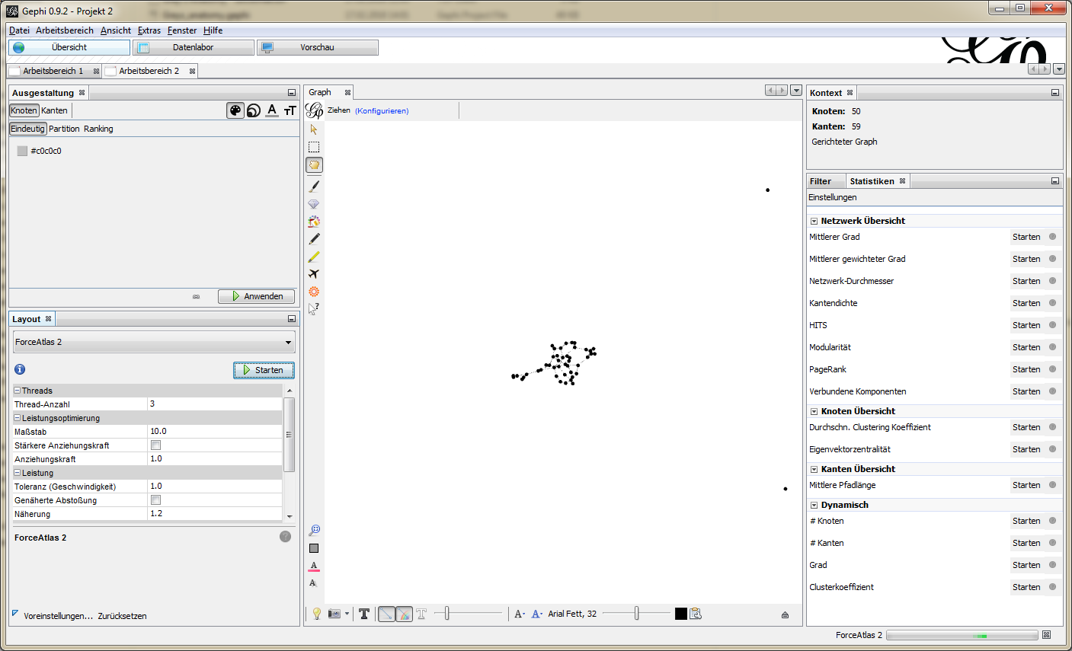
Creating a graph… in Gephi
Notes:
See also: https://github.com/rtidatascience/connected-nx-tutorial
And http://badhessian.org/2012/09/lessons-on-exponential-random-graph-modeling-from-greys-anatomy-hook-ups/
And https://github.com/briatte/awesome-network-analysis#datasets

Slide 14
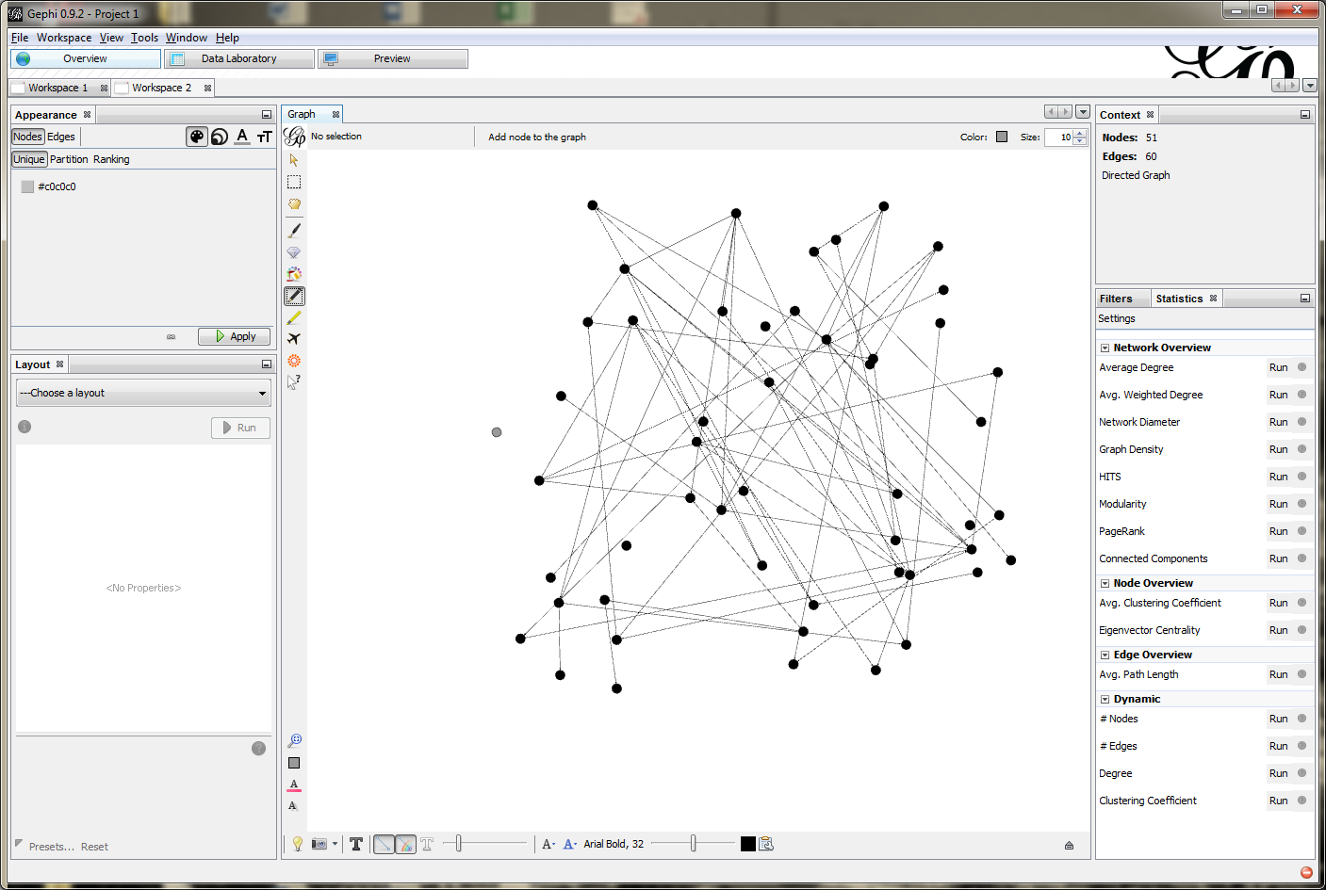
Adding nodes…
Notes:
See also: https://github.com/rtidatascience/connected-nx-tutorial
And http://badhessian.org/2012/09/lessons-on-exponential-random-graph-modeling-from-greys-anatomy-hook-ups/
And https://github.com/briatte/awesome-network-analysis#datasets

Slide 15
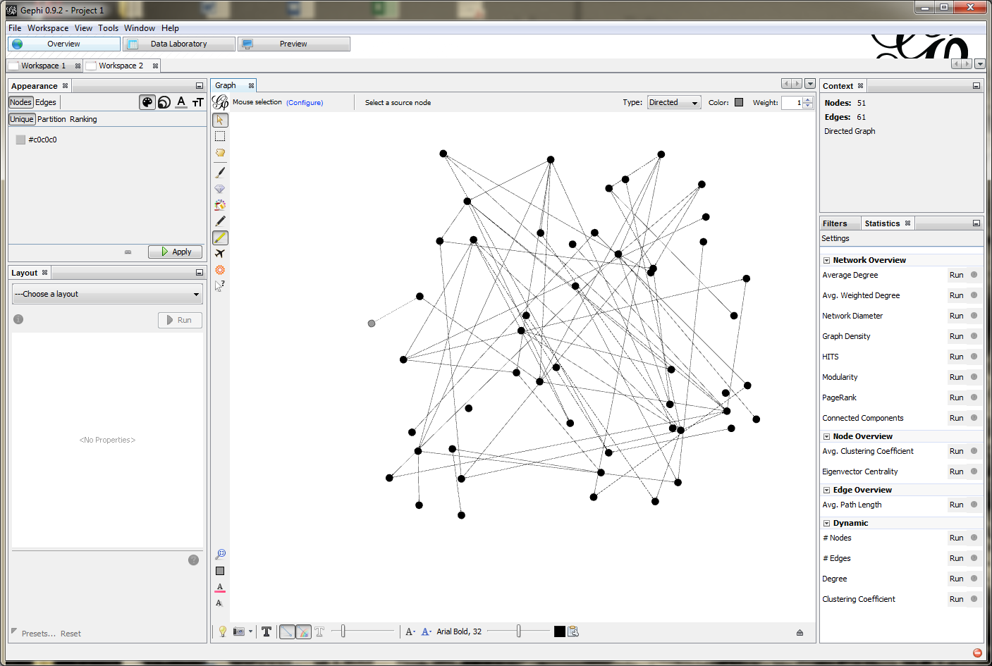
Adding links…
Notes:
See also: https://github.com/rtidatascience/connected-nx-tutorial
And http://badhessian.org/2012/09/lessons-on-exponential-random-graph-modeling-from-greys-anatomy-hook-ups/
And https://github.com/briatte/awesome-network-analysis#datasets

Slide 16
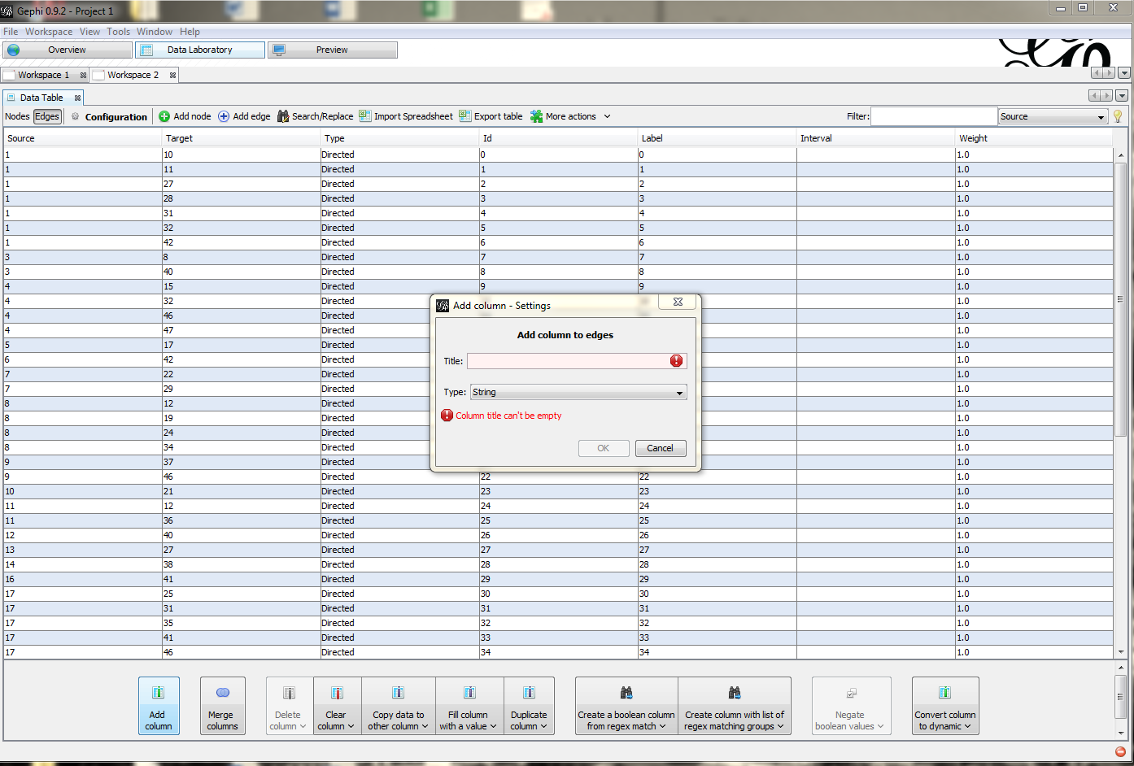
Adding and inspecting attributes…
This is to be done in the data laboratory.
Notes:
See also: https://github.com/rtidatascience/connected-nx-tutorial
And http://badhessian.org/2012/09/lessons-on-exponential-random-graph-modeling-from-greys-anatomy-hook-ups/
And https://github.com/briatte/awesome-network-analysis#datasets

Slide 17
Reading in different representations of graphs
Data for graphs and networks comes in many different representations.
Representations:
Link list
Adjacency matric
…
Note: representations are related to, but distinct from, the storage format. We will use csv-files for link lists and .dl for adjanceny matrices.
There are several other formats that we briefly touch upon such as .gexf, .graphml, and .gephi.
Notes:
See also: https://github.com/rtidatascience/connected-nx-tutorial
And http://badhessian.org/2012/09/lessons-on-exponential-random-graph-modeling-from-greys-anatomy-hook-ups/
And https://github.com/briatte/awesome-network-analysis#datasets

Slide 18

Grey‘s anatomy example data set
The dataset we'll look at is a record of all "romantic" encounters between characters on the TV show Grey's Anatomy
[Rob Chew and Peter Baumgartner]
Notes:
See also: https://github.com/rtidatascience/connected-nx-tutorial
And http://badhessian.org/2012/09/lessons-on-exponential-random-graph-modeling-from-greys-anatomy-hook-ups/
And https://github.com/briatte/awesome-network-analysis#datasets

Slide 19
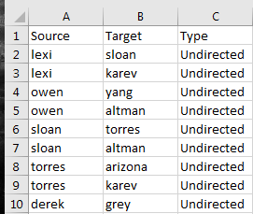
Edge lists
An edge list (aka link list) is a common way of representing a graph. This representation can be thought of as a list of tuples, where each tuple represents an edge between two of the nodes in your graph. The nodes of the graph can be inferred by taking the set of objects from all tuples.
You can infer/determine whether a graph is directed or weighted from an edge list.
Weighted: If edges appear more than once, or if an additional weight attribute is added as a 3rd column, the graph is weighted
Directed: If the "From" and "To" (often seen as "Source" and "Target") of an edge in the list is not arbitrary, it's a directed graph
01-Greys_anatomy_edgelist.csv

Slide 20
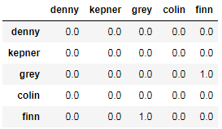
Adjacency matrices
A common way of representing graph data is through an adjacency matrix -- often referred to mathematically as A. This data structure is a square, n x n matrix where n = number of nodes. Each column and row in the matrix is a node. For any two nodes, i and j the value at Aij (row i and column j) represents the weight of the link between nodes i and j.

Slide 21
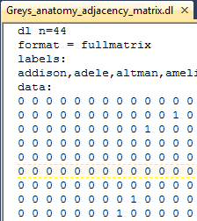
Adjacency matrices (continued): DL format
Greys_anatomy_adjacency_matrix.dl

Slide 22
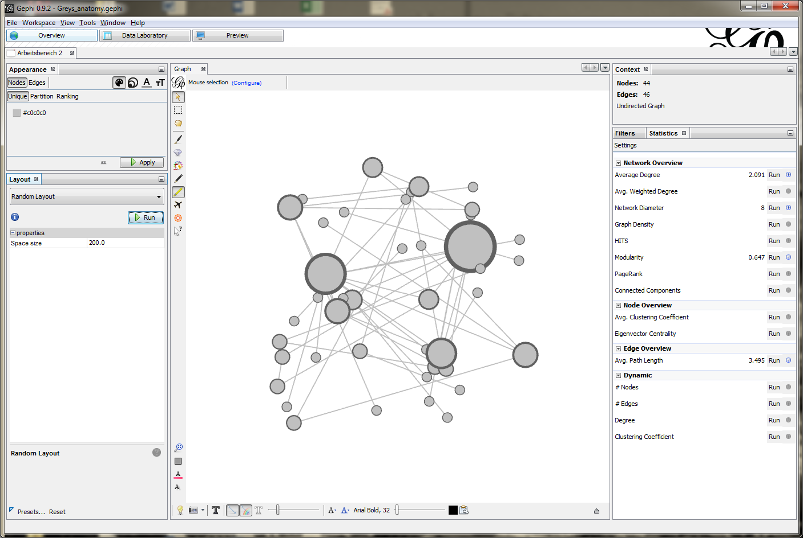
Summary statistics on graph…

Slide 23
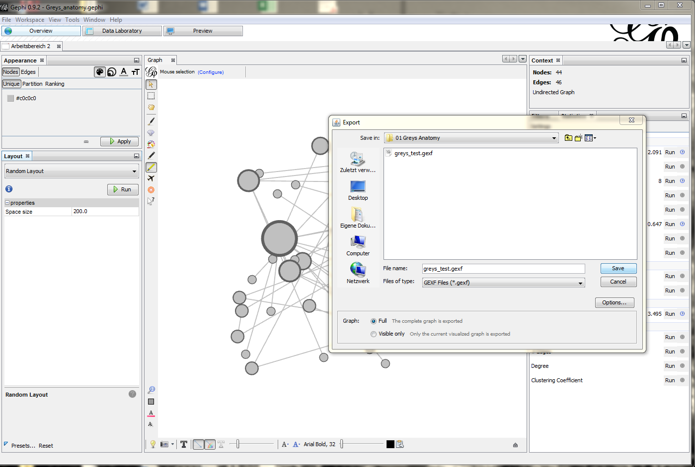
Exporting graphs
We'll export the graph in GEXF (Graph Exchange XML Format).

Slide 24
Exporting: Where to?
Analysis in other developer tools and packages
Iphyton/Jupyter and NetworkX (my package of choice)
Further python packages: igraph, D3 (visualization)
R (SNA package etc.)
…
Analysis in other packaged software programs
Ucinet
Pajek
Cytoscape
…

Slide 25
Agenda
Introduction and examples
Fundamental concepts
Creating graphs
Visualizing graphs
Centrality
Describing the macro structure
Community detection
Getting and handling data
Extended concepts
Discussion and conclusion

Slide 26
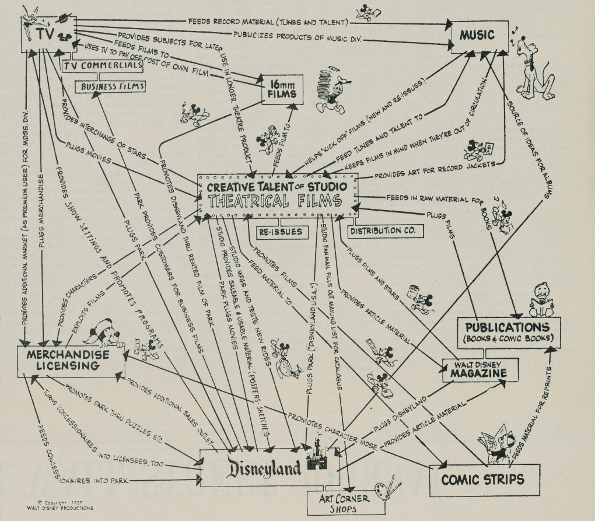
Layout algorithms
Vizualizing networks is a complicated problem -- how do you position the nodes and edges in a way such that no nodes overlap, connected nodes are near each other, none of the labels overlap? Typically we use what is called a layout to plot or visualize networks. A layout is an algorithm used to position nodes and edges on a plot automatically in aesthetically and informationally satisfactory ways.
There are several different layout algorithms, but the most common is a force-directed layout. These layout algorithms are based off of physical repulsion and spring systems. In general, the rule for force-directed layouts is: repel all nodes, and model connections between nodes as 'springs', with the result that more connected nodes will be closer together.
One important issue is that each layout typically has random initial conditions. Running a plot function twice will return two different plots, both following the rules of the algorithm, but differing due to the initial conditions of the layout.

Slide 27
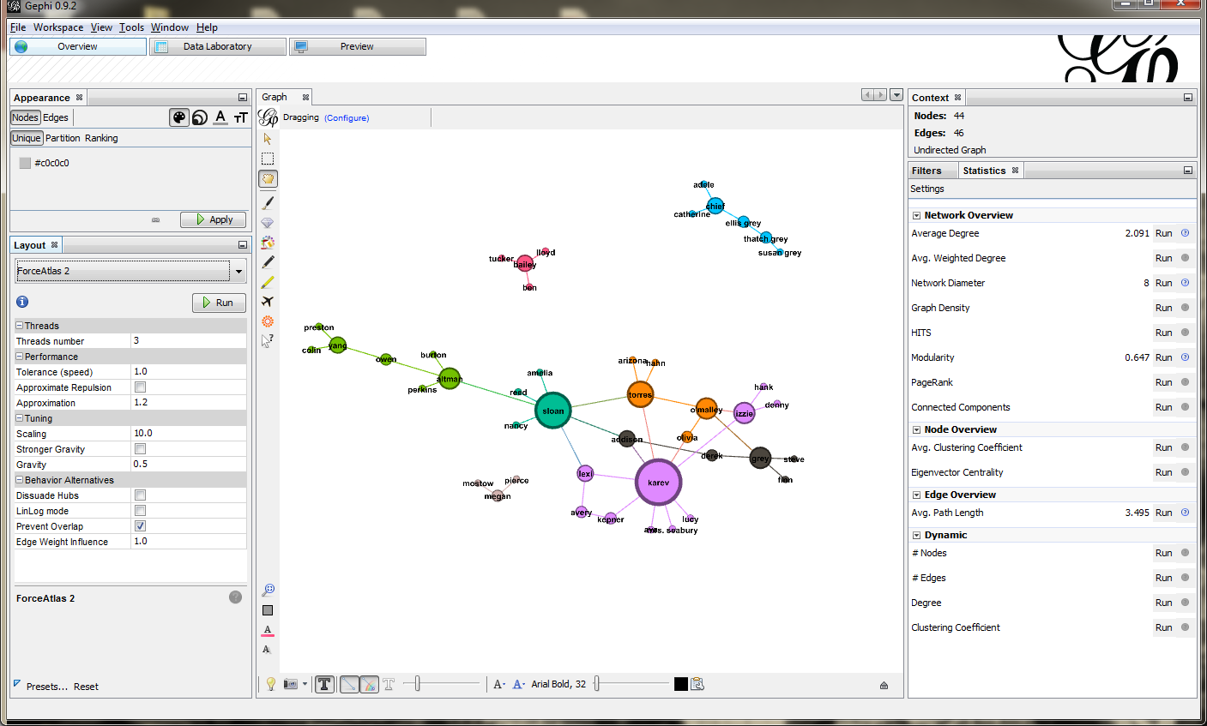
Layout algorithms

Slide 28
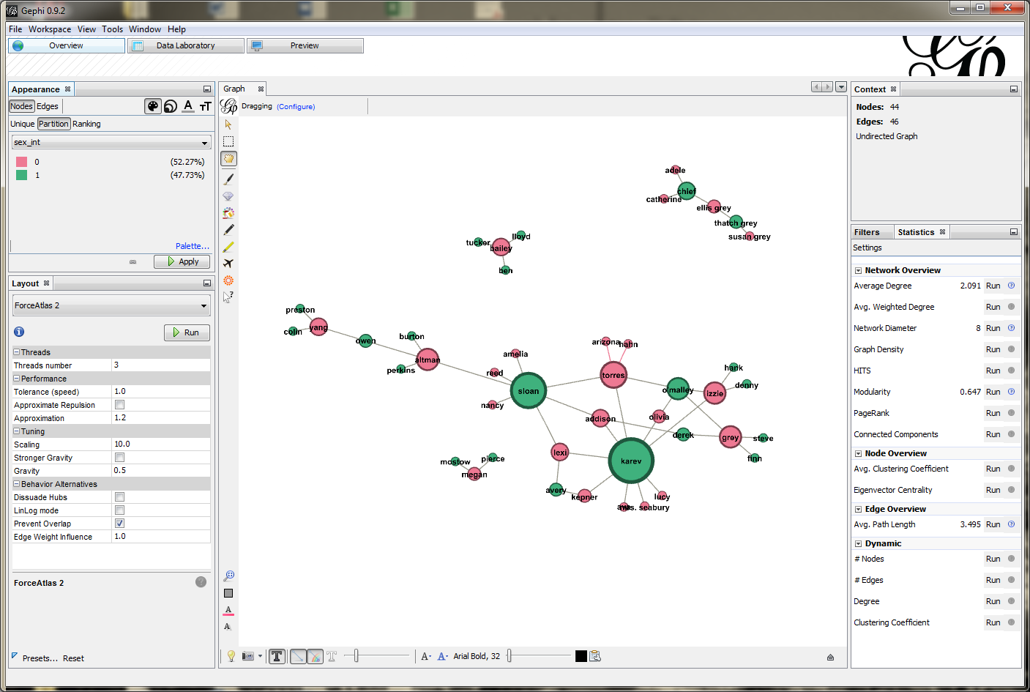
Detailed plotting with colors by attribute

Slide 29
Agenda
Introduction and examples
Fundamental concepts
Creating graphs
Visualizing graphs
Centrality
Describing the macro structure
Community detection
Getting and handling data
Extended concepts
Discussion and conclusion

Slide 30
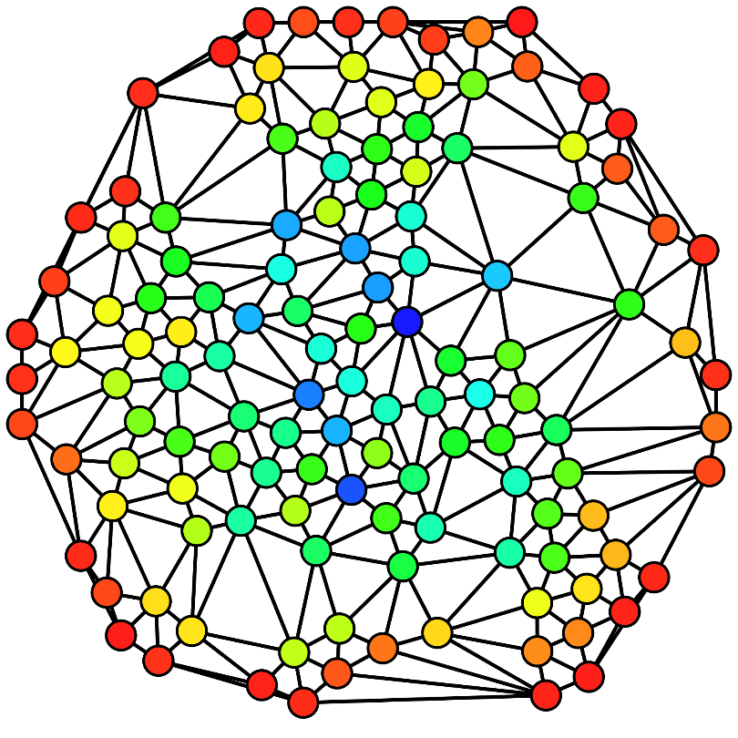
Centrality measures – overview
Definition of centrality
Compare and contrast popular centrality measures on dataset
Degree
Closeness
Betweenness
Eigenvector

Slide 31
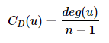
Degree centrality
The degree of a node is the number of other nodes to which it is connected.
Gephi‘s degree centrality is calculated as the absolute value. Other programs are taking the degree of the node and dividing by n-1 where n is the number of nodes in G.
NOTE: In a directed graph, both in-degree and out-degree centrality can be calculated.
Let's find the degree of our main character Grey (4).

Slide 32
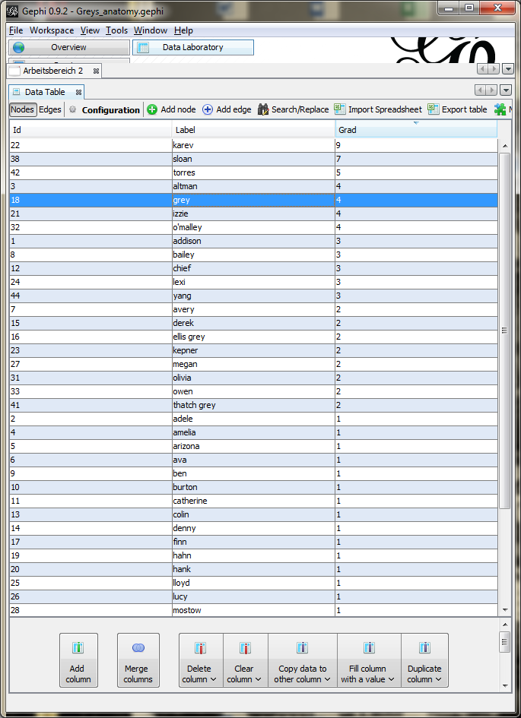
Likewise we find the degree of each cast member…

Slide 33
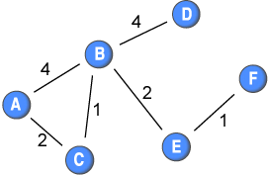
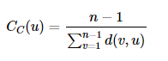
Closeness centrality
Closeness Centrality measures how many "hops" it would take to reach every other node in a network (taking the shortest path). It can be informally thought as 'average distance' to all other nodes.
In Gephi, it the reciporical of of the average value, which normalizes the value in a 0 to 1 range.

Slide 34
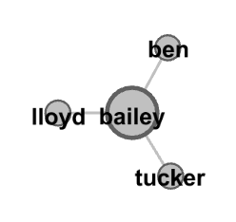
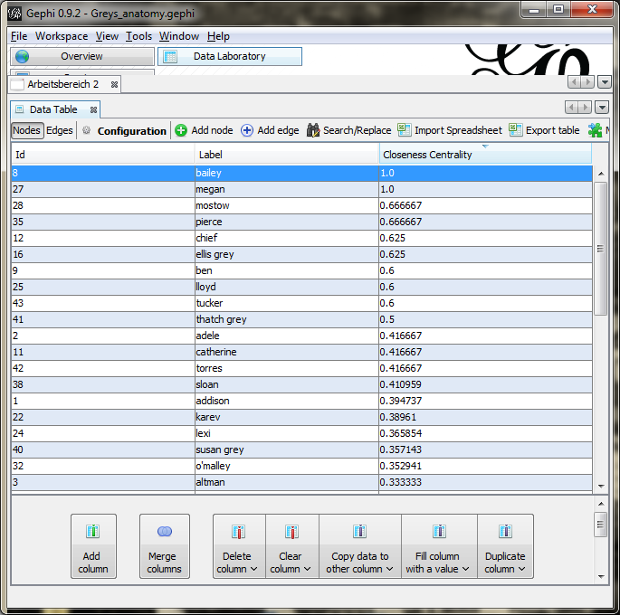
Closeness centrality
Why has Bailey a value of 1?
4 – 1
----------- = 1
1+1+1
NOTE: If the graph is not completely connected, this algorithm computes the closeness centrality for each connected part separately.

Slide 35
Why care about closeness centrality?
Degree centrality measures might be criticized because they only take into account the immediate ties that an actor has, or the ties of the actor's neighbors, rather than indirect ties to all others.
One actor might be tied to a large number of others, but those others might be rather disconnected from the network as a whole.
In a case like this, the actor could be quite central, but only in a local neighborhood.
Notes:
In our example, closeness centrality could perhaps help us understand which characters have the greatest potential to spread an infectous disease or STD across the cast (an admittedly dark plot arc).

Slide 36
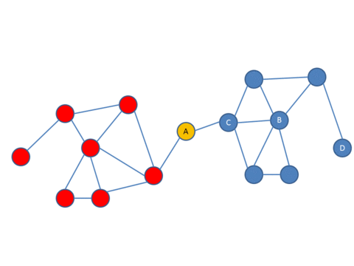
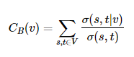
Betweenness centrality
Betweenness centrality quantifies the number of times a node acts as a bridge (or "broker") along the shortest path between two other nodes.
In this conception, nodes that have a high frequency to occur on a shortest path between two nodes have a high betweenness.
where σ(s,t) is total number of shortest paths from node s to node t and σ(s,t|v) is the number of those paths that pass through v.
Notes:
While this metric seems less relevent to our particular network, let's create a hypothetical situation:
To engage with a new romantic partner, you needed permission from at least one of their former partners and you could only send your request through existing partners (awkward 😬). Betweeness centrality would tell you which actors had the most effective veto power to thwart random requests made by a member to another random member in the network.

Slide 37
Why care about betweenness centrality?
Intermediaries occupy powerful positions
Boundary spanning and nexus work – connecting different subgraphs
Interpretation: Suppose you need permission from ex-partners to date. How many persons would Preston need to date Torres?
Notes:
Suppose that I want to influence you by sending you information, or make a deal to exchange some resources. But, in order to talk to you, I must go through an intermediary. For example, let's suppose that I wanted to try to convince the Chancellor of my university to buy me a new computer. According to the rules of our bureaucratic hierarchy, I must forward my request through my department chair, a dean, and an executive vice chancellor. Each one of these people could delay the request, or even prevent my request from getting through. This gives the people who lie "between" me and the Chancellor power with respect to me... Having more than one channel makes me less dependent, and, in a sense, more powerful.

Slide 38
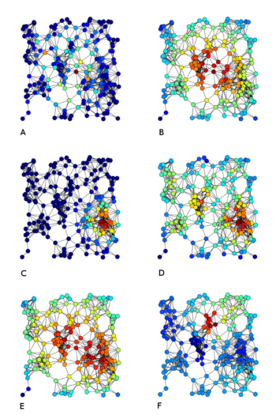
Eigenvector centrality
A node is high in eigenvector centrality if it is connected to many other nodes who are themselves well connected. Eigenvector centrality for each node is calculated as the proportional eigenvector values of the eigenvector with the largest eigenvalue.
Middle Left ("C"): Eigenvector Centrality. Middle Right ("D"): Degree Centrality

Slide 39
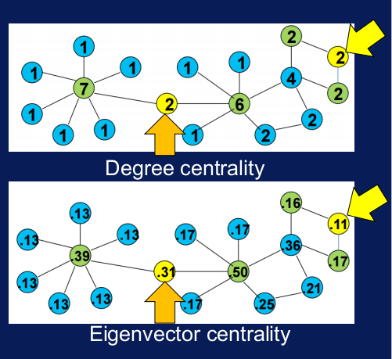
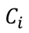
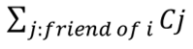
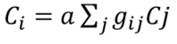
Eigenvector centrality
Centrality is proportional to the sum of centrality of the neighbors
is proportional to
_

Slide 40
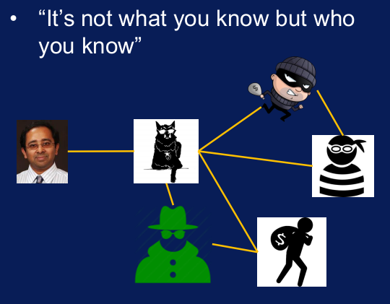
Eigenvector centrality: Interpretation
Pagerank is a variant of Eigenvector centrality (Intuition): A random surfer of a graph is most likely to find nodes that are highly “central” because a lot of nodes point to these nodes directly or indirectly

Slide 41
Pagerank
Pagerank is a variant of Eigenvector centrality
A random surfer of a graph is most likely to find nodes that are highly “central” because a lot of nodes point to these nodes directly or indirectly

Slide 42
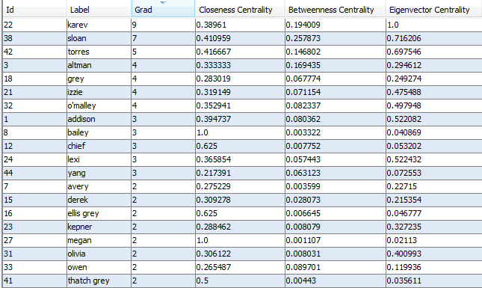
Comparison of different centrality measures

Slide 43
Agenda
Introduction and examples
Fundamental concepts
Creating graphs
Visualizing graphs
Centrality
Describing the macro structure
Community detection
Getting and handling data
Extended concepts
Discussion and conclusion

Slide 44
Describing complex relationships
Global properties of the network (macro level)
Degree distribution, average path length, density
Segregation patterns (meso level)
Types of nodes, modularity, and homophily
Local properties of single nodes (micro level)
Clustering coefficient, transitivity, …
Position of a node: Centrality, prestige, robustness,…

Slide 45
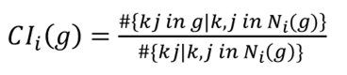
Clustering coefficient: from local to global
How many of Grey‘s former lovers did have a romantic relationship with each other?
Local clustering coefficient:
Global clustering coefficient: Scaled-up version averaged over all nodes in der network
Frequency of this link?
1
2
?
3

Slide 46
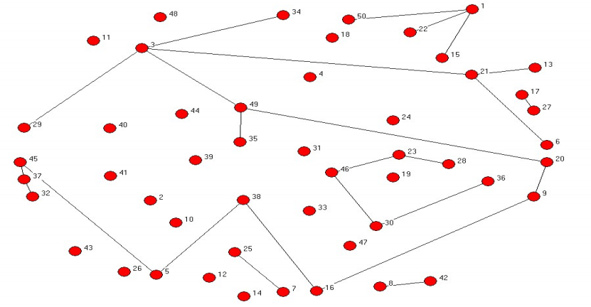
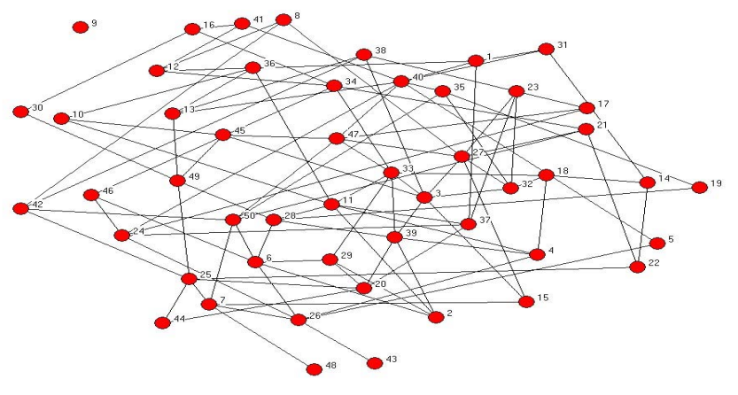
Density
A dense network is a network in which the number of links of each node is close to the maximal number of nodes. Each node is linked to almost all other nodes. The total connected case in which exactly each node is linked to each other node is called a completely connected network. Value ranges between 0 and 1.
Random network p=0.02, n=50
Random network p=0.05, n=50
Density: 0.019
Density: 0.055

Slide 47
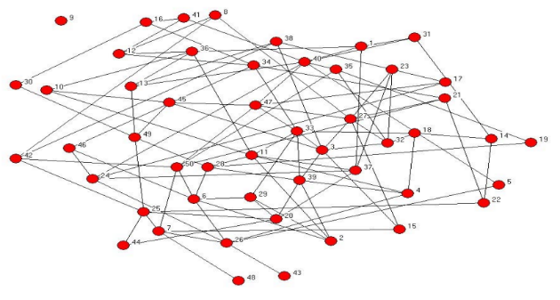
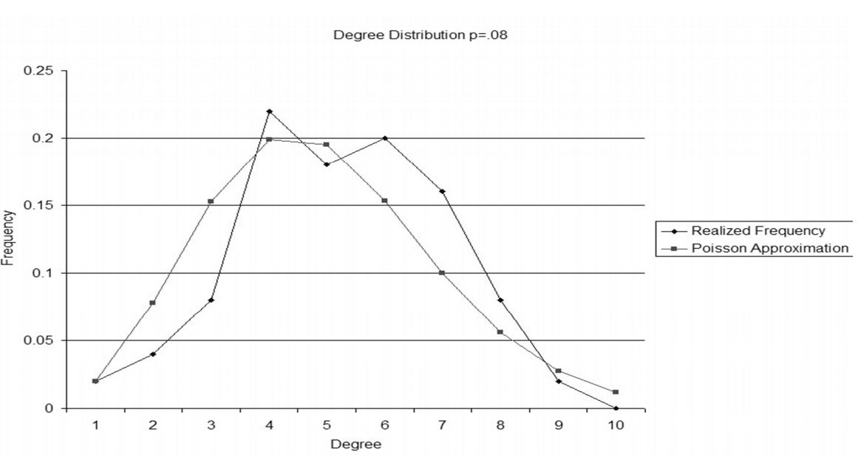
Degree distribution: Random network

Slide 48
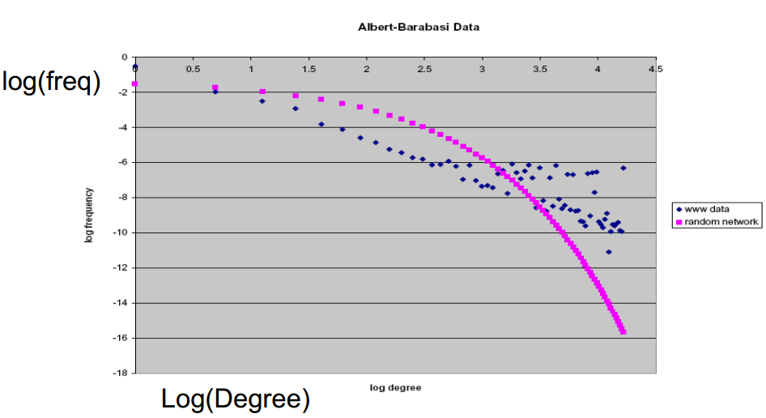
Degree distribution: Scale-free network
“Fat Tails“ (Price 1965), “Matthew Effect“ (The rich get richer, the poor get poorer“)
→ More degrees with high or low degrees, middle range ill-populated (no reg. to mean)

Slide 49
Degree distribution: Scale-free network

Slide 50
Agenda
Introduction and examples
Fundamental concepts
Creating graphs
Visualizing graphs
Centrality
Describing the macro structure
Community detection
Getting and handling data
Extended concepts
Discussion and conclusion

Slide 51
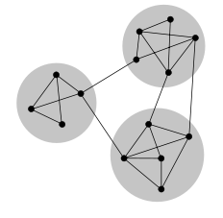
Community detection: intuition
“Where do I belong?“
Definitions
Modularity clustering
K-cores community detection

Slide 52
Community detection: intuition
Communities (also called partitions, clusters, groupings) in networks are sets of nodes that are more densely connected within a community than between other communities.
Community detection aims to reveal underlying community structure and can be handled in several different ways.

Slide 53
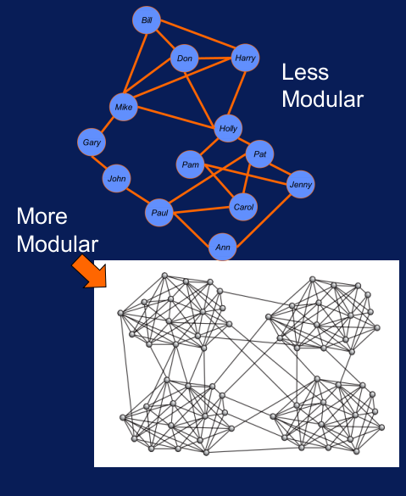
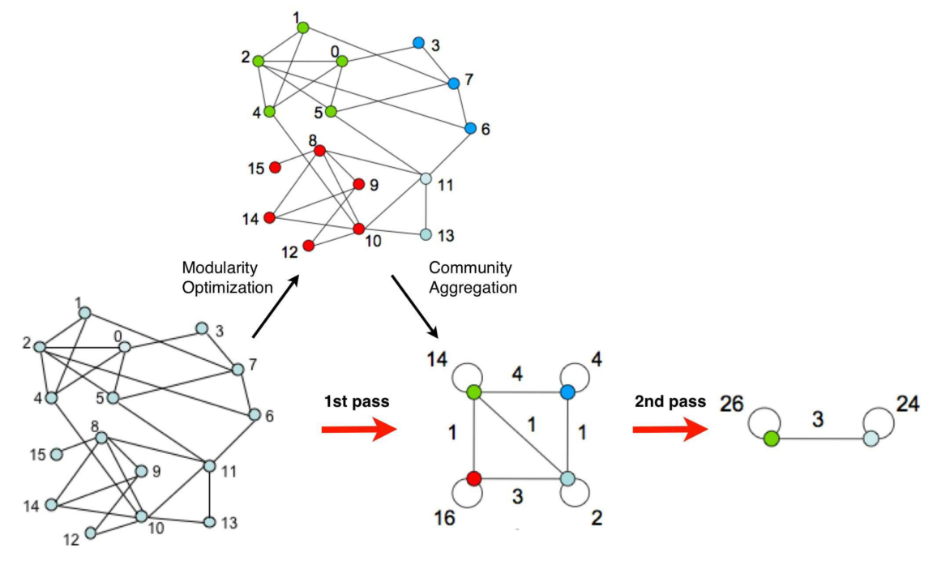
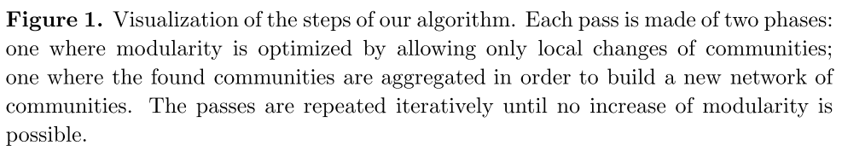
Modularity clustering: intuition
Modularity: A global measure of cluster quality
fraction of the edges within the given groups minus the expected such fraction if edges were distributed at random.
Value of the modularity lies in the range [−1/2,1).
Steps of the method:
[Blondel et al. 2008]

Slide 54
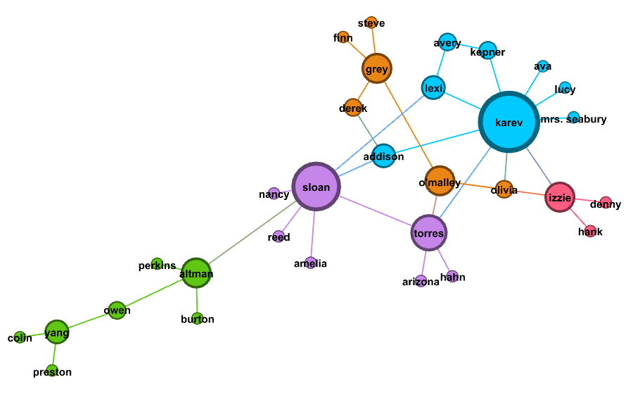
Modularity clustering: Different subgroups in the Grey‘s Anatomy cast

Slide 55
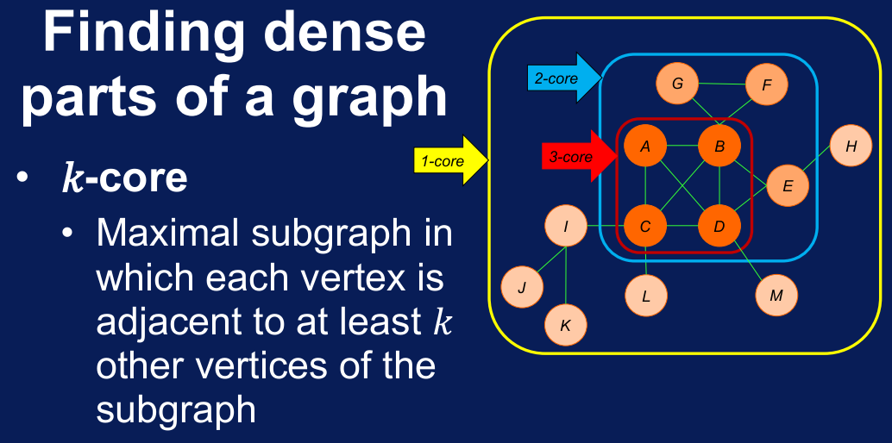
K-Core

Slide 56
Agenda
Introduction and examples
Fundamental concepts
Creating graphs
Visualizing graphs
Centrality
Community detection
Getting and handling data
Extended concepts
Discussion and conclusion

Slide 57
The “classical“ workflow for an SNA study
Formulate problem scope
Build hypotheses
Collect data
Survey data
Archival data
Visualize data
Analyze data

Slide 58
General ways to extract data from social media sites and other web sources
Ready-made software (e.g. Netvizz)
Uses existing APIs such as FBs Graph API, Twitters Streaming API or GitHub‘s REST API
Pros: Easy to use, intuitive
Cons: Often limited in scope or functionality, changes in API may make the program obsolete
Custom-developed code (e.g. Phyton)
Similarly builds on existing APIs but uses self-developed program code (e.g. Phyton and Project Jupyter)
Pros: More flexible than ready-made software
Cons: Learning curve, restricted by the APIs
Web scraping (e.g. Web scraper Chrome extension)
Uses scrapers to extract data from website code
Pros: Most flexible approach, in principle you can get all data that you can see or query on the web
Cons: Often very messy websites “polluted“ with Java Script, results may be mixed for various reasons

Slide 59
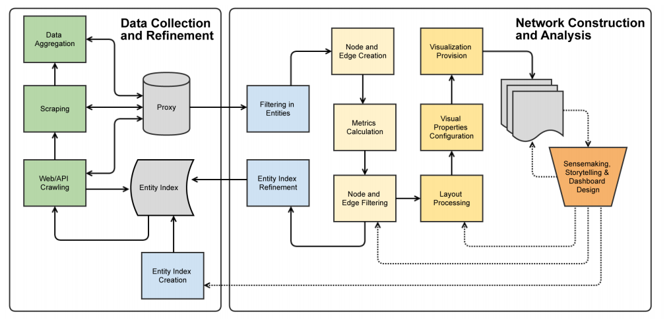
The data science paradigm to an SNA study…
[Huhtamäki 2016]

Slide 60
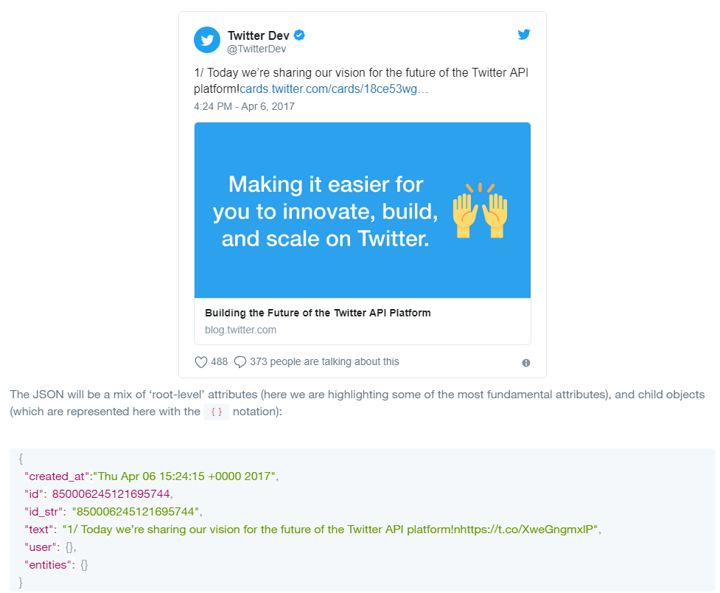
Twitter Streaming API: Understand the data structure

Slide 61
Twitter Streaming API: Possible networks to create
re-tweeting (retweet network)
replying (reply network) to existing tweets
mentioning (mention network) other users
friends/followers social relationships among user involved in the above activities
[http://snap.stanford.edu/data/higgs-twitter.html]

Slide 62
Twitter Streaming API: Getting set-up
Download Anaconda (includes Phyton)
Download Project Jupyter Notebook
Install the necessary packages (tweepy, simplejson)
Create a Twitter account
Create a Twitter application
Create the listener (next slide)
[https://github.com/jukkahuhtamaki/demo-twitter-collector]
Notes:
See also: https://github.com/jukkahuhtamaki/demo-twitter-collector
See also: https://www.afterhoursprogramming.com/tutorial/python/reading-files/

Slide 63

Twitter API: Building a listener with jupyter and tweepy

Slide 64

Twitter API: Writing output to stdout

Slide 65

Twitter API: Writing output to file

Slide 66

Twitter API: Parsing the file to create data set I

Slide 67

Twitter API: Parsing the file to create data set II

Slide 68

Import to Gephi for vizualization

Slide 69

Many kinds of nodes: Users, Tweets, URLs, Hashtags, Media Many kinds of edges: User creates Tweets, A Tweet is in response to another Tweet, A Tweet retweets another, User mentions User, Tweet contains Hashtag, User follows User
Extensions: Multipartite networks: Use a graph database (e.g. Neo4J)

Slide 70

One word about Facebook data…
Facebook Graph API has been constantly closed currently very hard to extract relevant information
Programs such as Netvizz help to extract information but limited to open groups, pages,…
Possibly you have to use web scrapers to extract relevant data

Slide 71

One word about Github data…
GitHub is a good source for information about socio-technical systems
GitHub API reasonably easy to use to extract relevant information
Currently less restricted with regards to extracting data from previous points in time
Fig.1: Otto.de open source repositorities & developer communities

Slide 72
Other potential sources
Programmable Web provides information about available mashaups and API ecosystems
LinkedIn has a phyton API and some tools to do automatic analysis (e.g. Socilab)

Slide 73
Agenda
Introduction and examples
Fundamental concepts
Creating graphs
Visualizing graphs
Centrality
Community detection
Getting and handling data
Extended concepts
Discussion and conclusion

Slide 74


Designing a network study: Motivation
“Organizational Architecture”
“IT Architecture”
?

Slide 75
Dependent Variable: Application Governance (Horizontal Allocation of Decision Rights)
1. IT-owned applications (n=30)
Planning decisions with central IT
Change coordination responsibility within central IT
2. Business-owned applications (n=96)
Planning decisions with a BU-IT
Change coordination responsibility within central IT
3. End user-owned applications (n=73)
Planning decisions with a business unit
Change coordination responsibility with central IT
4. End user-managed applications (n=26)
Planning decisions with a business unit
Change coordination responsibility with a business unit

Slide 76
Dependent Variable: Application Governance (Horizontal Allocation of Decision Rights)
Est. | Sig.
-.325 | .002
-.189 | .179
-.098 | .001
1.023 | .000
Scope of Use
The breadth to which the system is used throughout the organization
Operationalization: #users (binned into 5 classes)
H1: Higher scope of use → more IT decision rights
Technical Specificity
The degree to which the system is customized to the organization
5 classes: cloud sw, standard sw, mod. ssw., custom-modular, custom
H2: Higher technical specificity → more IT decision rights
Positional Value
The number of other systems depending on this system
Operationalization: out-degree (numerical)
H3: Higher positional value → more IT decision rights
Neighbor Governance
The extent to which neighboring systems are planned by business or IT units
Avg. planning decision rights of direct neighbors in graph (numerical)
H4: decision rights of neighbors → decision rights (positive correlation)

Slide 77
Conclusions & Next Steps
Evidence for an application-level complementarity between „organizational architecture“ and “IT architecture”
Linking two formerly separated strands of literature
IT Governance (traditionally on „monolithic“ org-level)
IT Architecture (young stream of quantitative network views)
Practical and theoretical implications: More differentiated, pluralistic view at IT Governance
Caveat: Lack of criterion / limited prescriptiveness
Next steps
Qualitative analysis of within-case outliers
Exploring reasons for deviating from statistical patterns

Slide 78

Chain of Reasoning and Validity Issues in Network Analysis with Digital Trace Data
[Howison et al. 2011]

Slide 79



Group exercise: What research design has been used in these studies?
Group 1: Aral et al. (2009)
Group 2: Dahlander & Fredriksen (2012)
Group 3: Basole et al. (2015)

Slide 80
Discussion

Slide 81
Agenda
Introduction and examples
Fundamental concepts
Creating graphs
Visualizing graphs
Centrality
Community detection
Getting and handling data
Extended concepts
Discussion and conclusion

Slide 82
Exercise: Design your own network study.

Slide 83
Discussion

Slide 84
PhD Course on Social Network Analysis
Prof. Dr. Daniel Fürstenau 20 February 2017

